Slide 1
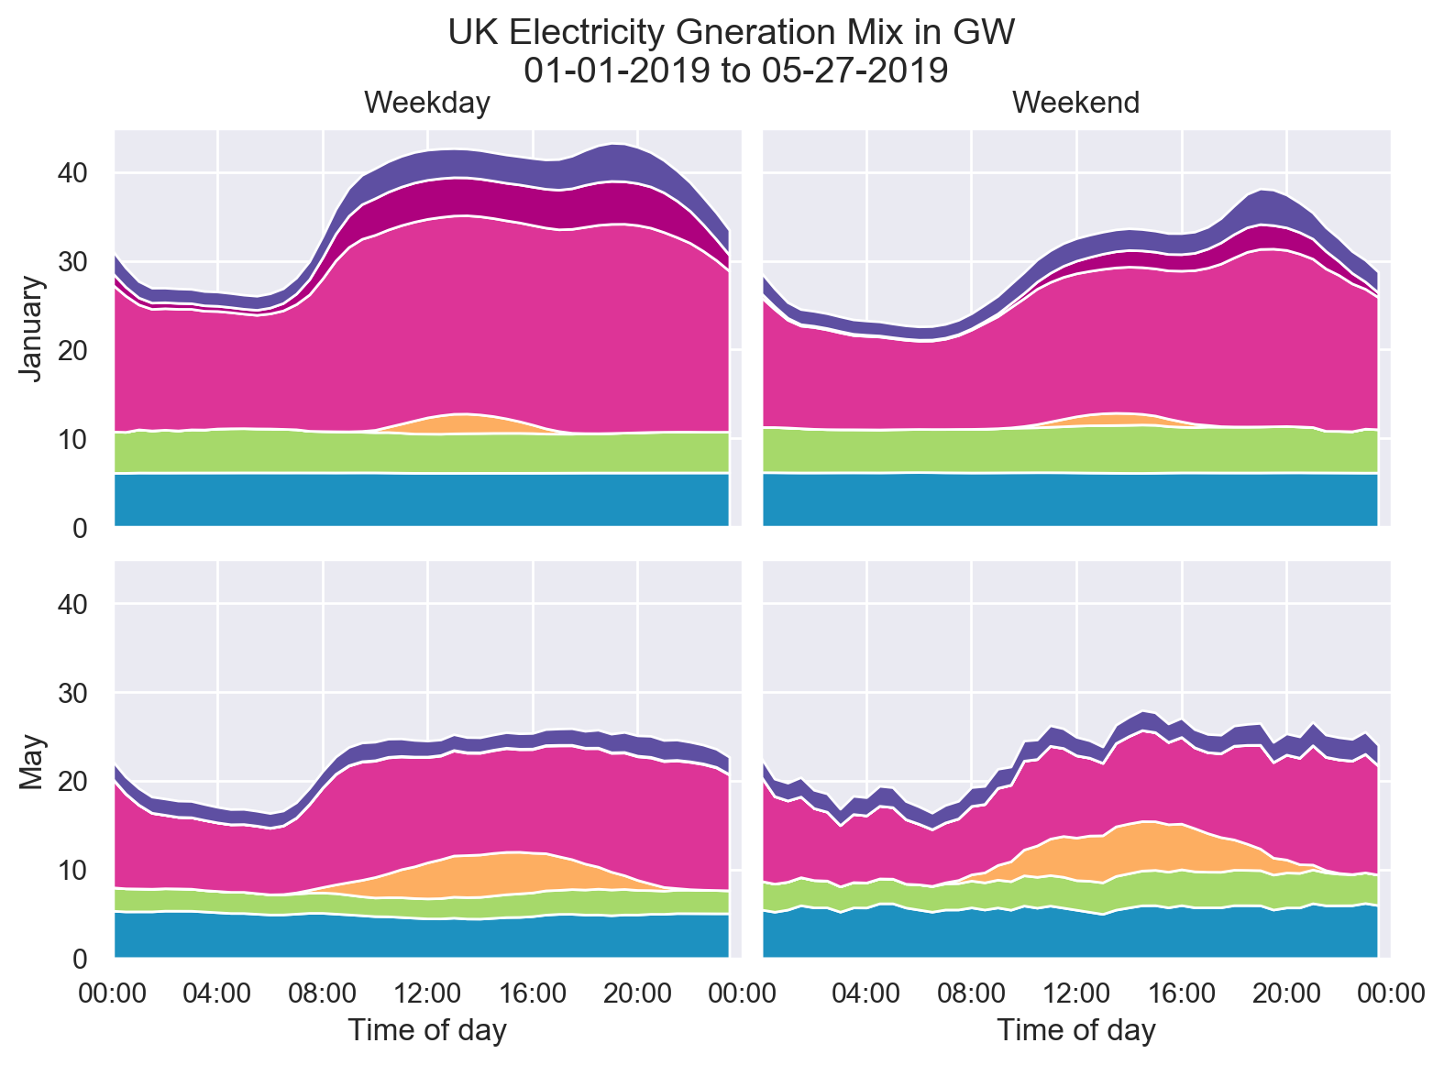






other
coal
natural gas
wind
solar
nuclear

Slide 2
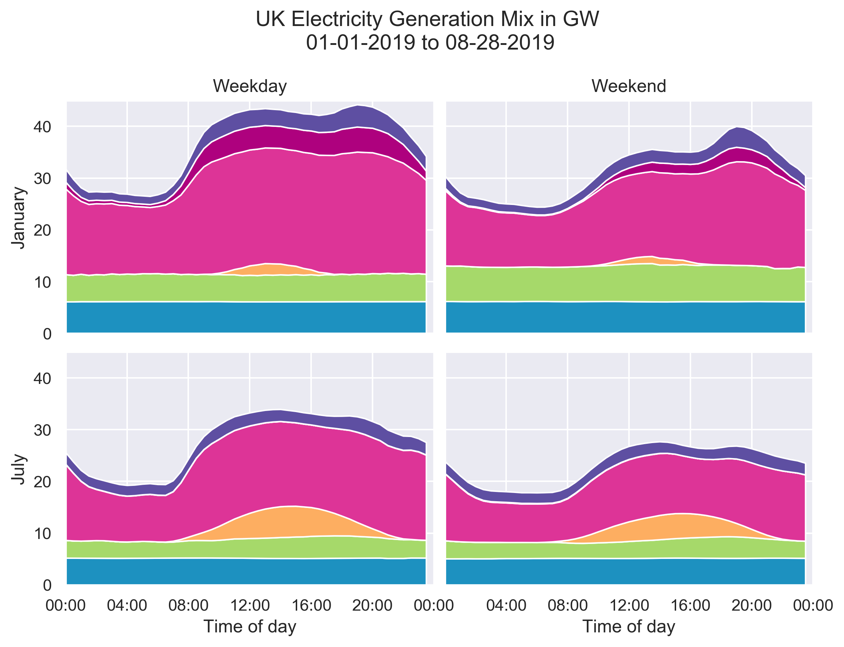
other
coal
natural gas
wind
solar
nuclear

Slide 3
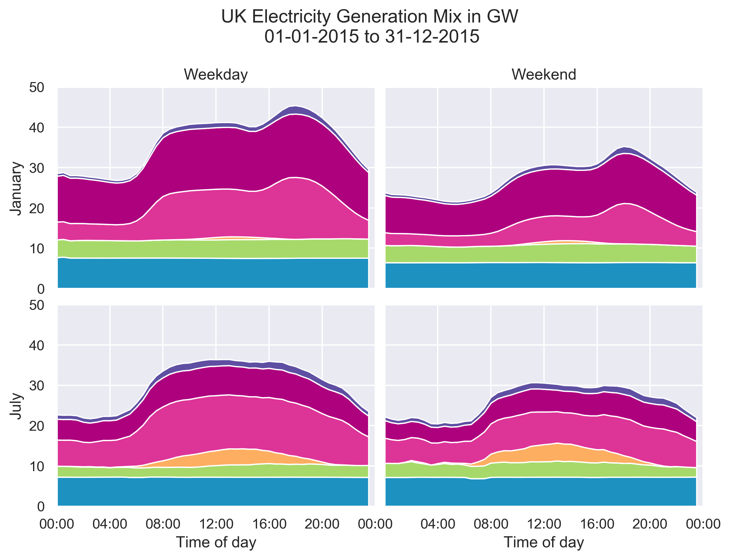
other
coal
natural
gas
wind
solar
nuclear

Slide 4
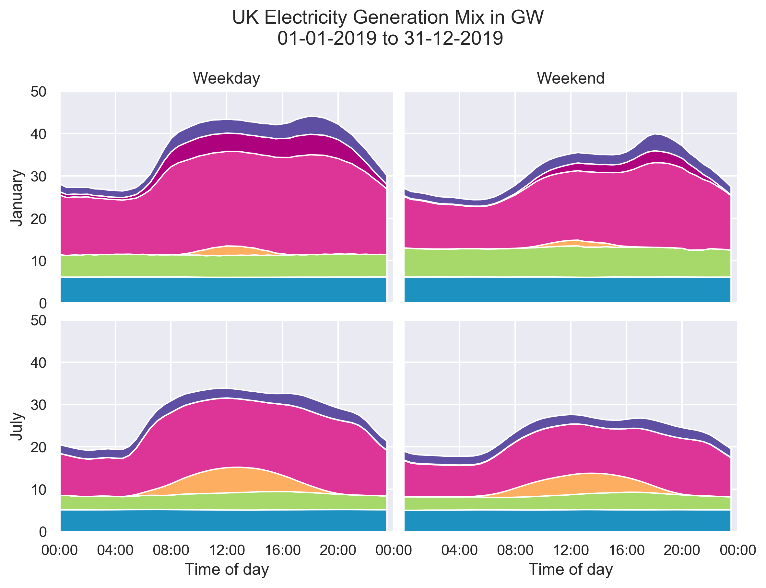
other
coal
natural gas
wind
solar
nuclear

Slide 5

other
coal
natural
gas
wind
solar
nuclear

Slide 6

other
coal
natural gas
wind
solar
nuclear

